Slide 1
Old Paradians’ Association
RACV Club Lunch
8 March 2023
Educational changes in a Parade College context
#tenetetraditiones

Slide 2
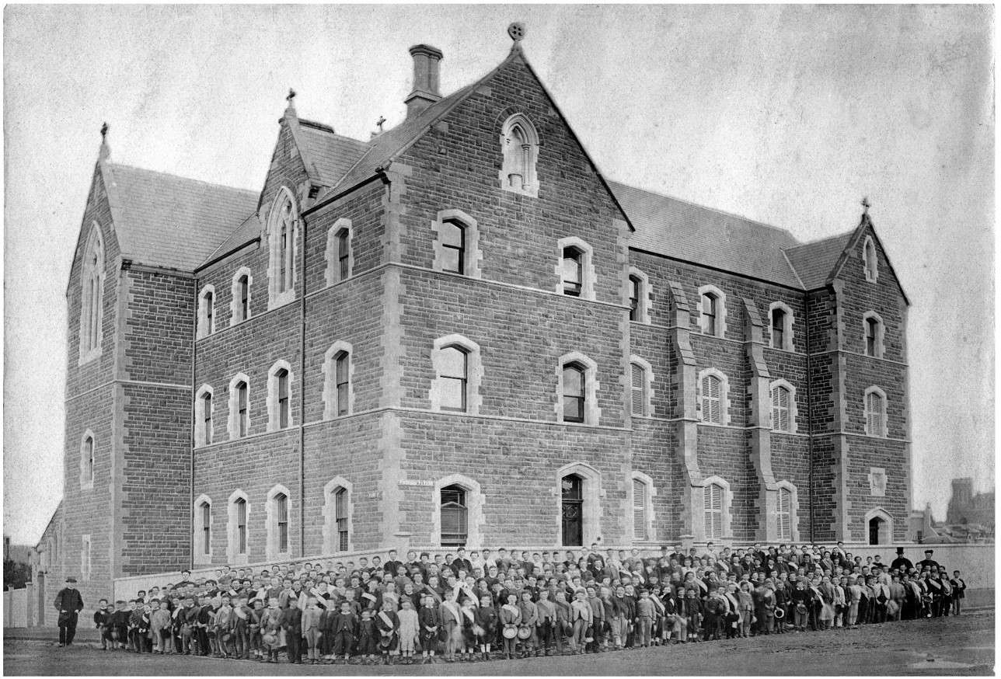
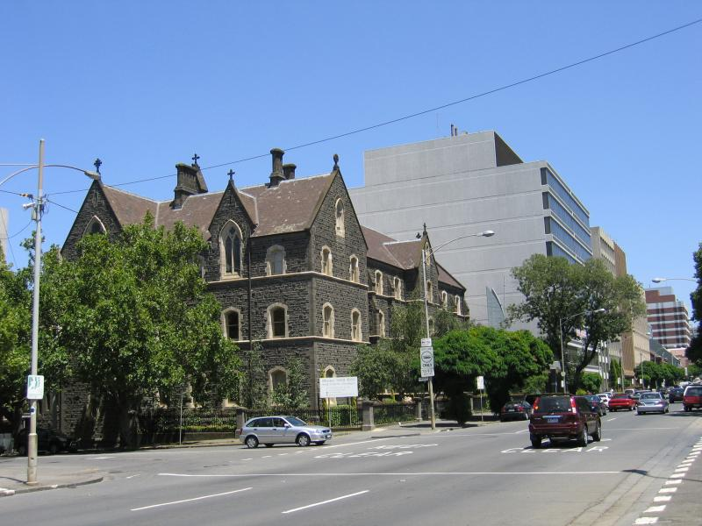
The only constant is change!
First day of classes at Parade College, Victoria Parade, East Melbourne, 1871
The site of Parade College today

Slide 3
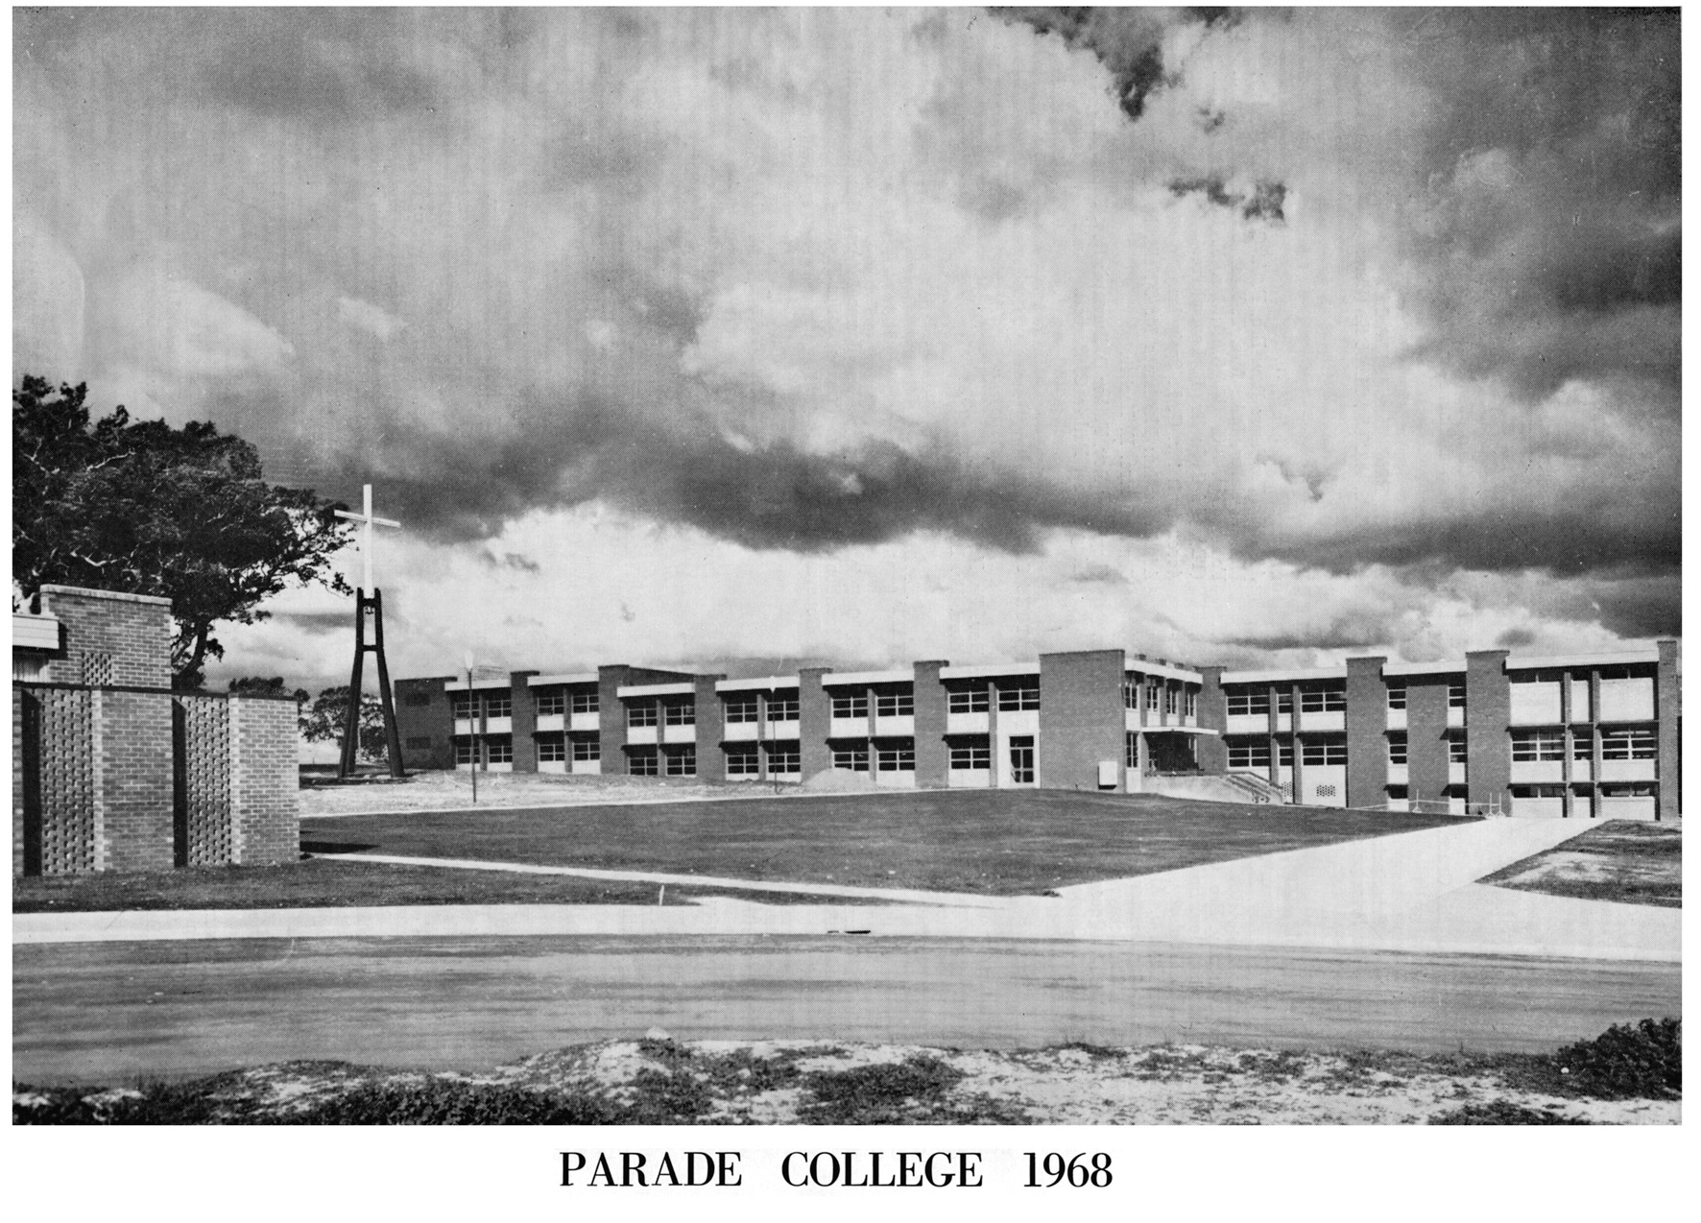
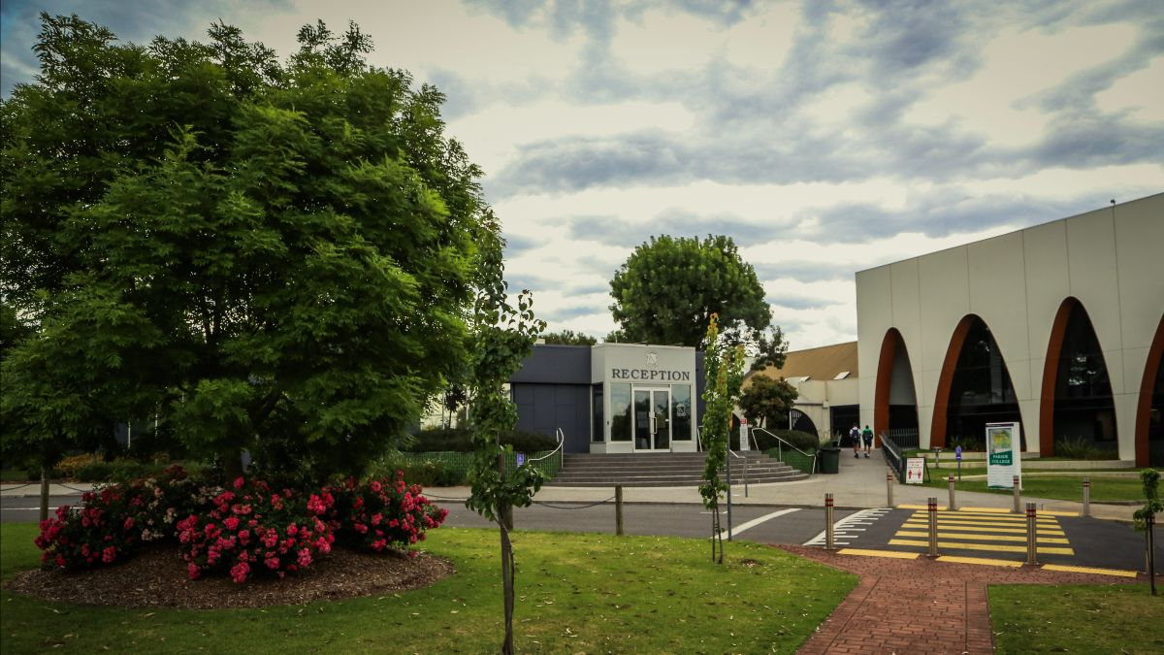
Parade College, Alphington
Parade College, Bundoora, 1968
Parade College, today

Slide 4
The senior level of secondary schooling has gone through significant changes:
1950’s and 1960’s | Proficiency, Intermediate, Leaving and Matriculation and in very many cases, a Second Year Matriculation
1970’s | Introduction of the Higher School Certificate (HSC) which remained until 1992
1990’s | Introduction of the Victorian Certificate of Education (VCE), a 2-year Year 11 & 12 qualification
2003 | Introduction of the Victorian Certificate of Applied Learning (VCAL) – a vocationally based senior secondary qualification
2023 | Introduction of a new Senior Secondary Certificate that replaces the VCAL called the VCE VM (Vocational Major), a 2-year, Year 11 and 12 qualification
All qualifications are governed by the Victorian Curriculum and Assessment Authority VCAA

Slide 5
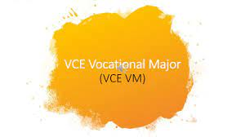
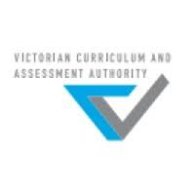
Education has been hijacked by acronyms!!
VCE VM, VCE, VET, VCAL, ASQA,RTO, VRQA, ATAR, NON SCORED,NON ATAR GAT, SAC, CAT, CDSM, T and L, SBAT
Learning Outcomes, Key Knowledge, Key Skills, Employability Skills,
Internal Assessment, Levels of Achievement, Assessment Tasks,

Slide 6
Vocational Education and Training
VET
Students in their VCE can combine their mainstream VCE subjects with a VET Certificate II, III or IV
Students doing the VCE VM MUST do a minimum of 180 hours of recognised VET training to achieve the qualification
Parade College is one of the biggest providers of VET training in the north. We are a Registered Training Organisation (RTO)

Slide 7
Vocational Education and Training
VET@ Parade
Building and Construction Cert II, III
Bricklaying Cert II, III
Plumbing Cert II Pre-apprenticeship, III Apprenticeship
Small Business Cert II
Business Cert IV
Sport and Recreation Cert III
Sport Development Cert IV
Electro technology Cert II
Furnishings Cert II
Hospitality Kitchen Operations Cert III
Music Industry Skills Cert III
Laboratory Skills Cert II
Information Communication Digital Technology
Community Service Cert II

Slide 8
Parade College | A world of Opportunities
Different pathways for different young men
VCE VM students complete a senior secondary certificate that is more ‘hands on’, focusing on applied learning and a vocationally based program leading to employment, apprenticeships, traineeships, further education and training.
Very many have been able to commence an apprenticeship while at school! (SBAT)
Some go on to university to complete a degree, for example: Construction Management, Business, Teaching

Slide 9
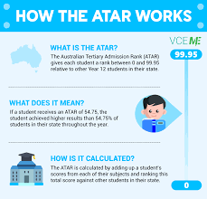
VCE Pathways
2 Year Program – Years 11 & 12
Cannot qualify for a VCE or VCE VM without completing a minimum number of units across Year 11 & 12
Year 11 complete units 1 & 2 of a chosen subject
Year 12 complete units 3 & 4 of a chosen subject
Some capable students ACCELERATE, meaning they can complete Unit 3 & 4 subjects in Year 11
Year 12 subjects (Unit 3 & 4) have End of Year examinations, generally worth 50% of an overall study score
Study Scores are to a maximum of 50 (perfect score) in each subject
All Unit 3 & 4 study scores are combined to create an ATAR (ranking of student achievement)
Score to a maximum of 99.95 (Perfect score)
The ATAR is used to look at minimum requirements for entering a University Course

Slide 10
Parade College Today
Some Images

